Slide 1

Chapter 30 Networking

Slide 2
Objectives
To explain terms: TCP, IP, domain name, domain name server, stream-based communication, and packet-based communications (§30.2).
To describe sockets, server sockets, and client sockets (§30.2).
To implement Java networking programs using stream sockets (§30.2).
To obtain Internet addresses using the InetAddress class (§30.3).
To develop servers for multiple clients (§30.4).
To develop applets that communicate with the server (§30.5).
To send and receive objects on a network (§30.6).
To create applications or applets to retrieve files from a network (§30.7).
To render HTML files using the JEditorPane class (§30.8).

Slide 3
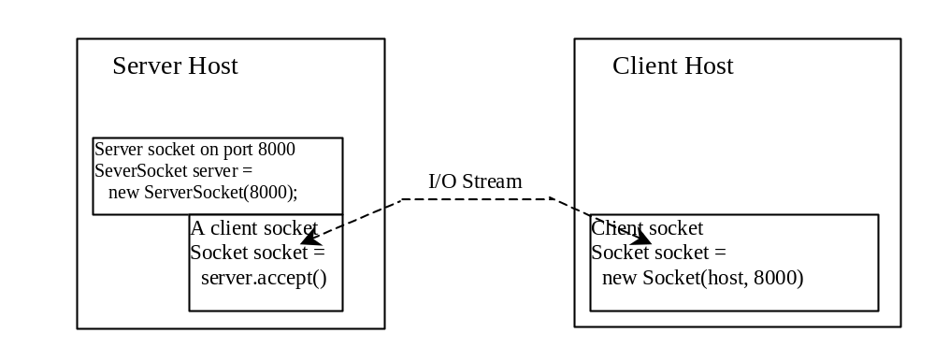
Client/Server Communications
The server must be running when a client starts. The server waits for a connection request from a client. To establish a server, you need to create a server socket and attach it to a port, which is where the server listens for connections.
After the server accepts the connection, communication between server and client is conducted the same as for I/O streams.
After a server socket is created, the server can use this statement to listen for connections.
The client issues this statement to request a connection to a server.

Slide 4
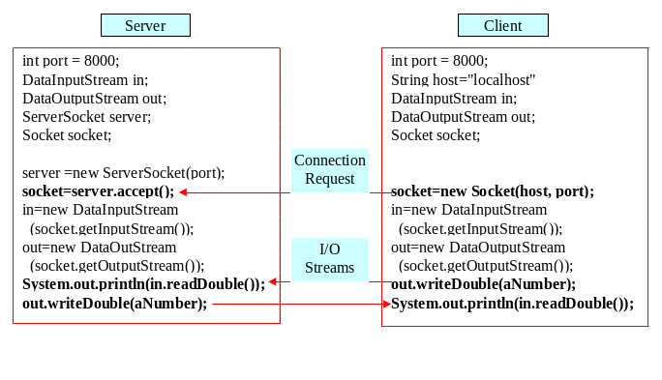
Data Transmission through Sockets
InputStream input = socket.getInputStream();
OutputStream output = socket.getOutputStream();

Slide 5
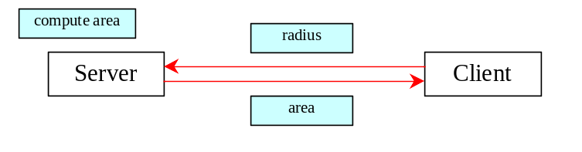
A Client/Server Example
Problem: Write a client to send data to a server. The server receives the data, uses it to produce a result, and then sends the result back to the client. The client displays the result on the console. In this example, the data sent from the client is the radius of a circle, and the result produced by
the server is the area of the circle.

Slide 6
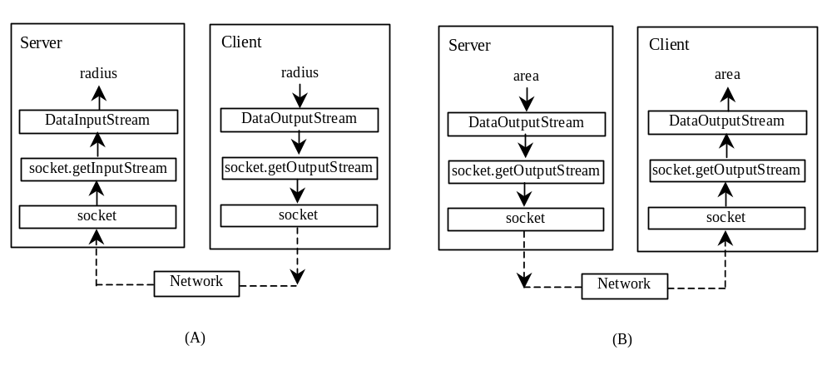
A Client/Server Example, cont.

Slide 7
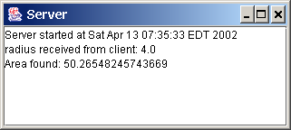
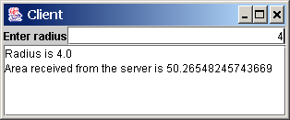
A Client/Server Example, cont.
Server Code
Client Code
Start Server
Start Client
Note: Start the server, then the client.

Slide 8
The InetAddress Class
Occasionally, you would like to know who is connecting to the server. You can use the InetAddress class to find the client's host name and IP address. The InetAddress class models an IP address. You can use the statement shown below to create an instance of InetAddress for the client on a socket.
  InetAddress inetAddress = socket.getInetAddress();
Next, you can display the client's host name and IP address, as follows:
  System.out.println("Client's host name is " +
  inetAddress.getHostName());
  System.out.println("Client's IP Address is " +
  inetAddress.getHostAddress());

Slide 9
Serving Multiple Clients
Multiple clients are quite often connected to a single server at the same time. Typically, a server runs constantly on a server computer, and clients from all over the Internet may want to connect to it. You can use threads to handle the server's multiple clients simultaneously. Simply create a thread for each connection. Here is how the server handles the establishment of a connection:
    while (true) {
    Socket socket = serverSocket.accept();
    Thread thread = new ThreadClass(socket);
    thread.start();
    }
The server socket can have many connections. Each iteration of the while loop creates a new connection. Whenever a connection is established, a new thread is created to handle communication between the server and the new client; and this allows multiple connections to run at the same time.

Slide 10
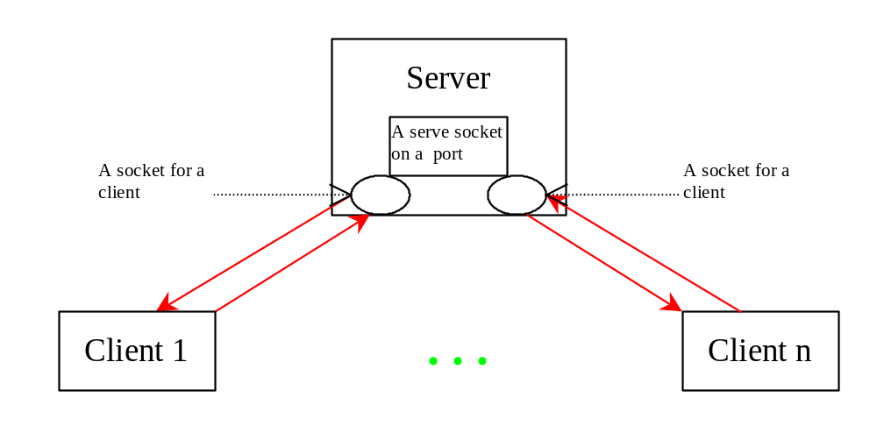
Example: Serving Multiple Clients
Server for Multiple Clients
Start Server
Start Client
Note: Start the server first, then start multiple clients.

Slide 11
Applet Clients
Due to security constraints, applets can only connect to the host from which they were loaded. Therefore, the HTML file must be located on the machine on which the server is running.

Slide 12

Example: Creating Applet Clients
Write an applet that shows the number of visits made to a Web page. The count should be stored in a file on the server side. Every time the page is visited or reloaded, the applet sends a request to the server, and the server increases the count and sends it to the applet. The applet then displays the new count in a message, such as You are visitor number 11.
CountServer
AppletClient
Start Server
Start Client

Slide 13
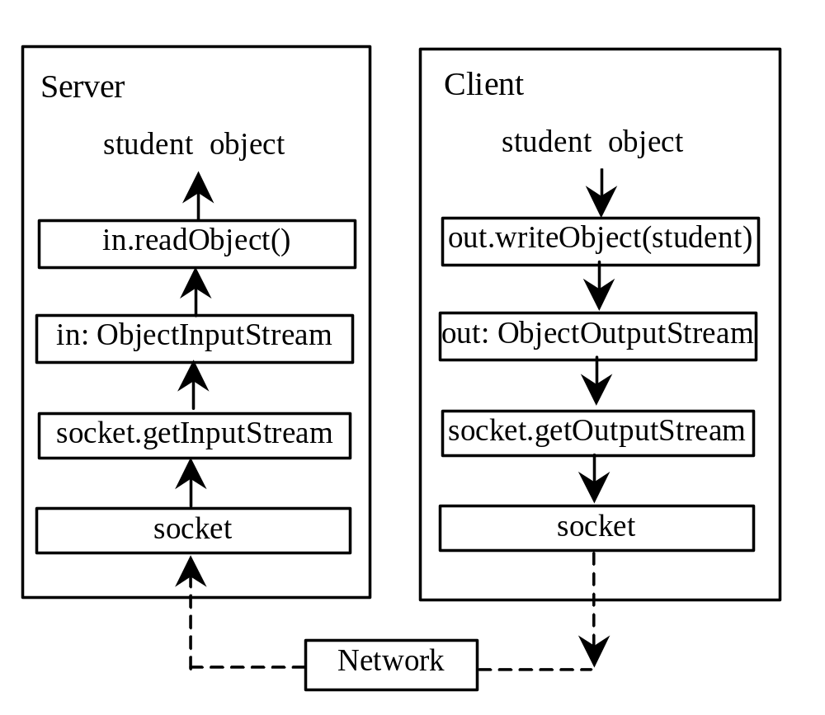
Example: Passing Objects in Network Programs
Write a program that collects student information from a client and send them to a server. Passing student information in an object.
Student Class
Student Sever
Student Client
Start Server
Start Client
Note: Start the server first, then the client.

Slide 14
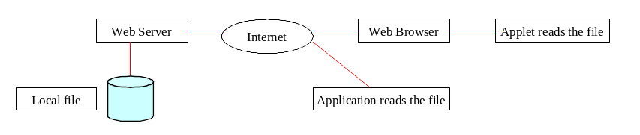
Retrieving Files from Web Servers
You developed client/server applications in the previous sections. Java allows you to develop clients that retrieve files on a remote host through a Web server. In this case, you don’t have to create a custom server program. The Web server can be used to send the files to the clients.

Slide 15
The URL Class
Audio and images are stored in files. The java.net.URL class can be used to identify the files on the Internet. In general, a URL (Uniform Resource Locator) is a pointer to a "resource" on the World Wide Web. A resource can be something as simple as a file or a directory. You can create a URL object using the following constructor:
  public URL(String spec) throws MalformedURLException
For example, the following statement creates a URL object for http://www.sun.com:
  try {
  URL url = new URL("http://www.sun.com");
  }
  catch(MalformedURLException ex) {
  }

Slide 16
Creating a URL Instance
To retrieve the file, first create a URL object for the file. The java.net.URL. For example, the following statement creates a URL object for http://www.cs.armstrong.edu/liang/index.html.
  URL url = new URL("http://www.cs.armstrong.edu/liang/index.html");
You can then use the openStream() method defined in the URL class to open an input stream to the file's URL.
  InputStream inputStream = url.openStream();

Slide 17
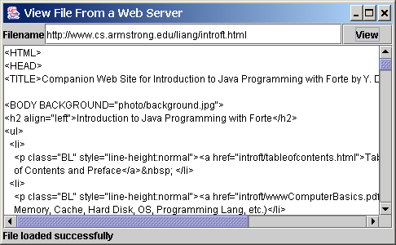
Example: Retrieving Remote Files
This example demonstrates how to retrieve a file from a Web server. The program can run as an application or an applet. The user interface includes a text field in which to enter the URL of the filename, a text area in which to show the file, and a button that can be used to submit an action. A label is added at the bottom of the applet to indicate the status, such as File loaded successfully or Network connection problem.
ViewRemoteFile
Run

Slide 18
JEditorPane
Swing provides a GUI component named javax.swing.JEditorPane that can be used to display plain text, HTML, and RTF files automatically. So you don’t have to write code to explicit read data from the files. JEditorPane is a subclass of JTextComponent. Thus it inherits all the behavior and properties of JTextComponent.
To display the content of a file, use the setPage(URL) method as follows:
  public void setPage(URL url) throws IOException
JEditorPane generates javax.swing.event.HyperlinkEvent when a hyperlink in the editor pane is clicked. Through this event, you can get the URL of the hyperlink and display it using the setPage(url) method.

Slide 19
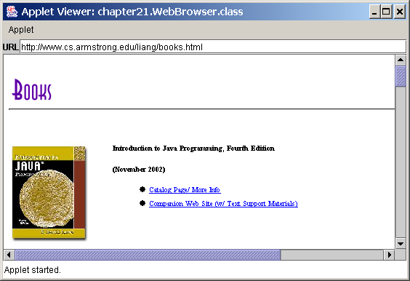
Example: Creating a Web Browser
Viewing HTML Files Using the JEditorPane. JEditorPane can be used to display HTML files.
WebBrowser
Run

Slide 20
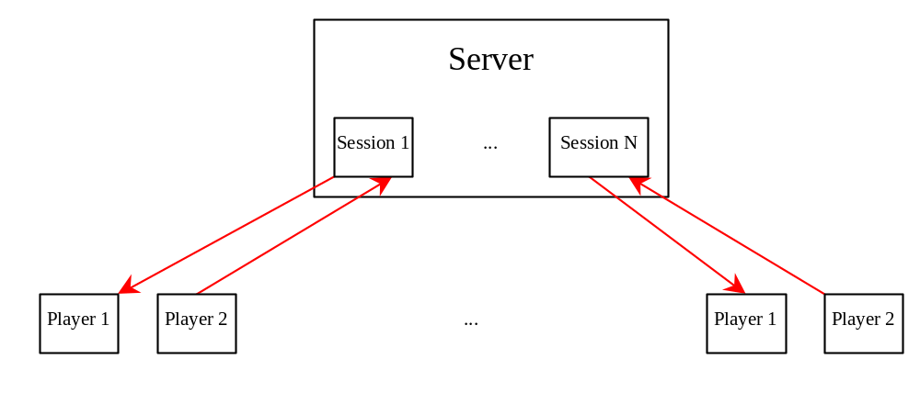
Case Studies: Distributed TicTacToe Games
Optional
TicTacToeServer
Run Server
TicTacToeClient
Run Client

Slide 21
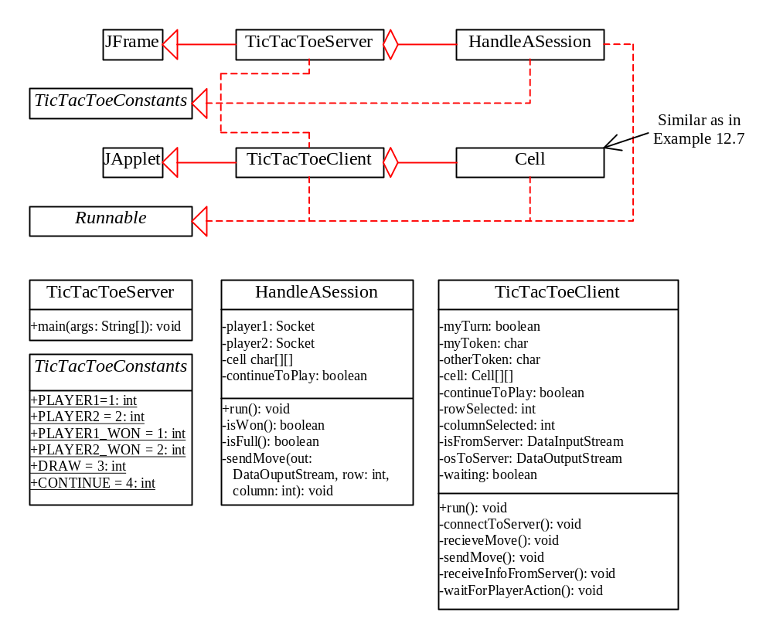
Distributed TicTacToe, cont.

Slide 22
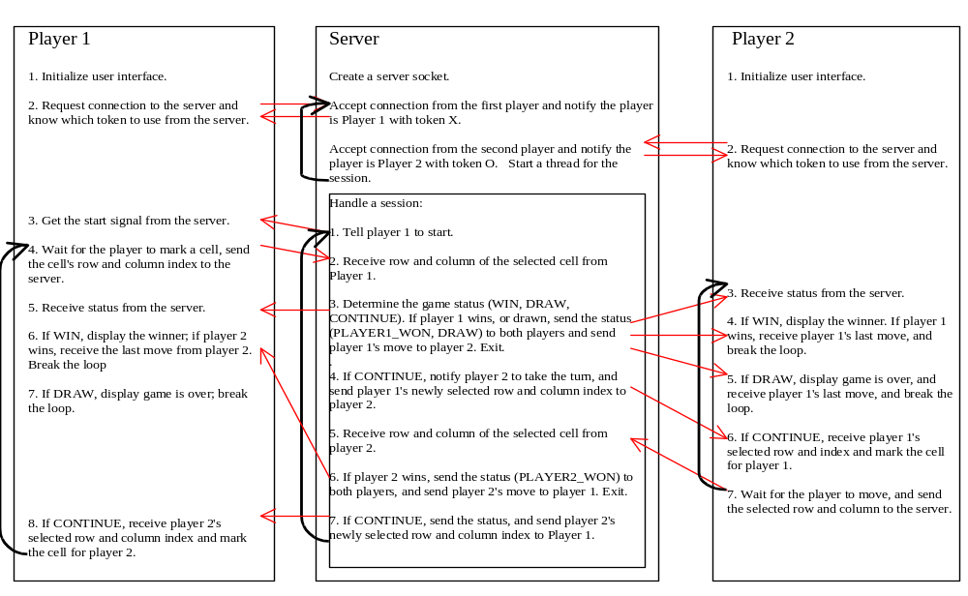
Distributed TicTacToe Game

Slide 23
Stream Socket vs. Datagram Socket
Stream socket
Datagram socket
A dedicated point-to-point channel between a client and server.
Use TCP (Transmission Control Protocol) for data transmission.
Lossless and reliable.
Sent and received in the same order.
No dedicated point-to-point channel between a client and server.
Use UDP (User Datagram Protocol) for data transmission.
May lose data and not 100% reliable.
Data may not received in the same order as sent.

Slide 24
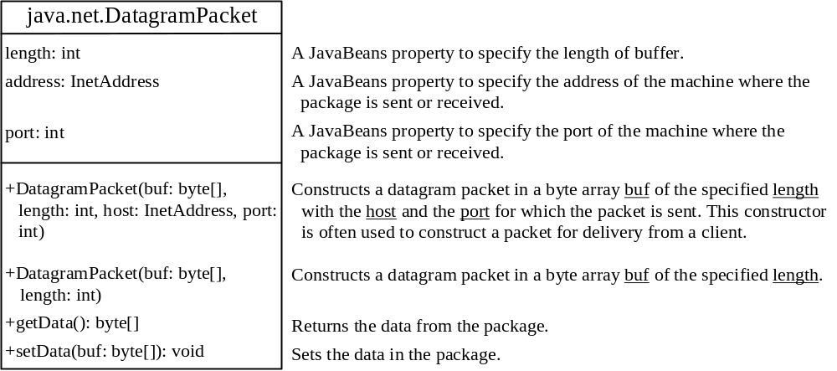
DatagramPacket
Companion Website
The DatagramPacket class represents a datagram packet. Datagram packets are used to implement a connectionless packet delivery service. Each message is routed from one machine to another based solely on information contained within the packet.

Slide 25
DatagramSocket
Companion Website
DatagramSocket
Create a server DatagramSocket
Create a client DatagramSocket
The DatagramSocket class represents a socket for sending and receiving datagram packets. A datagram socket is the sending or receiving point for a packet delivery service. Each packet sent or received on a datagram socket is individually addressed and routed. Multiple packets sent from one machine to another may be routed differently, and may arrive in any order.
To create a server DatagramSocket, use the constructor DatagramSocket(int port), which binds the socket with the specified port on the local host machine.
To create a client DatagramSocket, use the constructor DatagramSocket(), which binds the socket with any available port on the local host machine.

Slide 26
Sending and Receiving a DatagramSocket
Companion Website
Sending
Receiving
To send data, you need to create a packet, fill in the contents, specify the Internet address and port number for the receiver, and invoke the send(packet) method on a DatagramSocket.
To receive data, create an empty packet and invoke the receive(packet) method on a DatagramSocket.

Slide 27
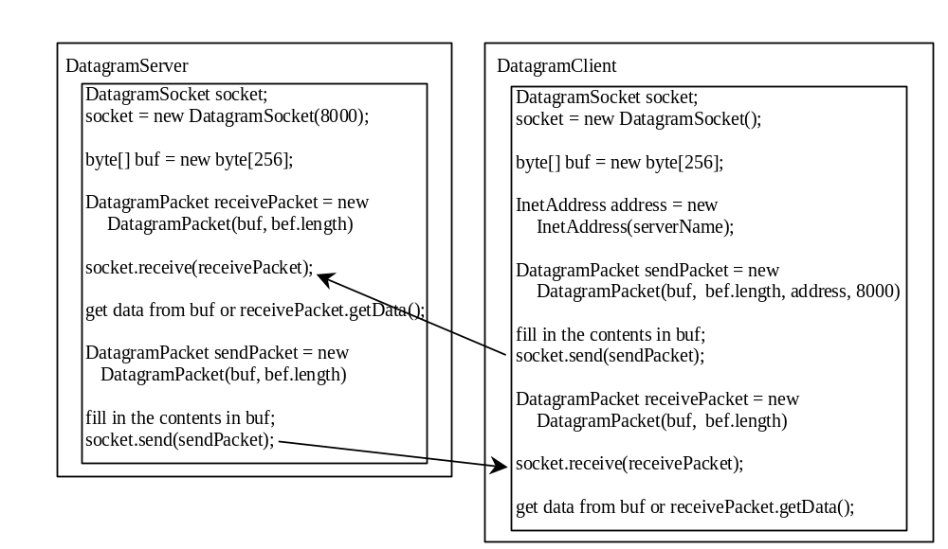
Datagram Programming
Companion Website
Datagram programming is different from stream socket programming in the sense that there is no concept of a ServerSocket for datagrams. Both client and server use DatagramSocket to send and receive packets.
Designate one a server

Slide 28
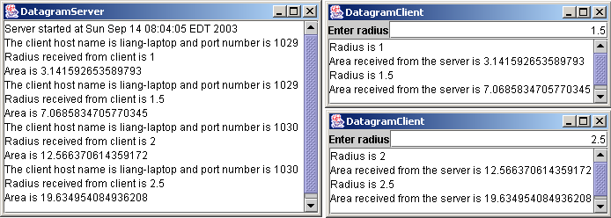
Example: A Client/Server Example
Companion Website
Section 30.2 presents a client program and a server program using socket streams. The client sends radius to a server. The server receives the data, uses them to find the area, and then sends the area to the client. Rewrite the program using datagram sockets.
Server Code
Client Code
Note: Start the server, then the client.
Start Server
Start Client

